Slide 1


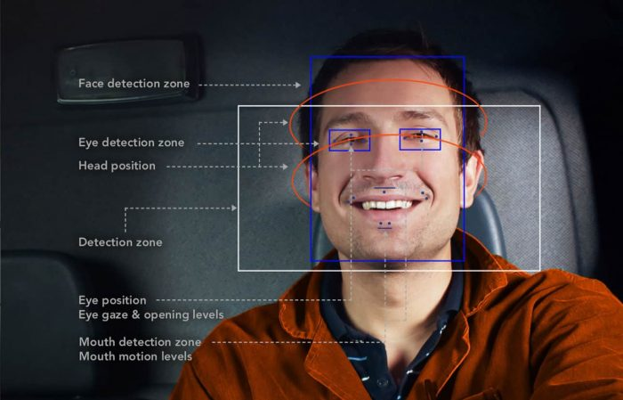
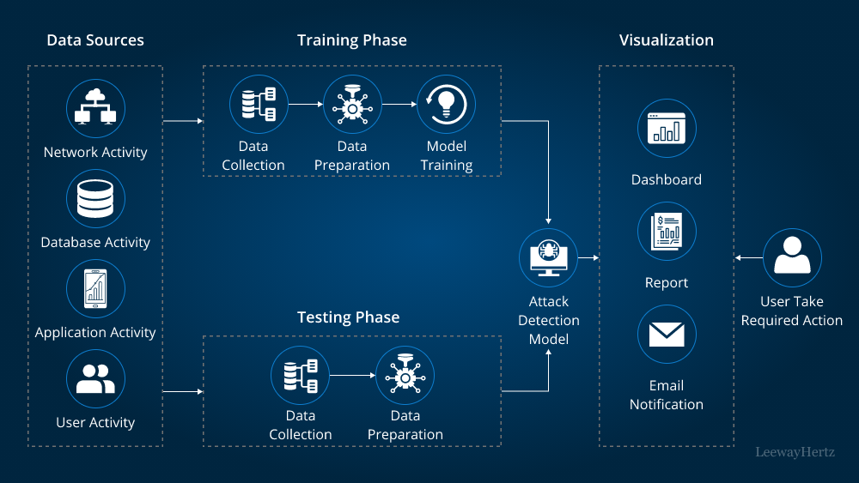
Title :
AI-Assisted
Distracted Driver Detection System
Road accidents are a major public health concern in India, claiming millions of lives annually.
Road accidents claim around 1.5 million lives in India every year, contributing 11% to the total number of such fatalities globally

Slide 2
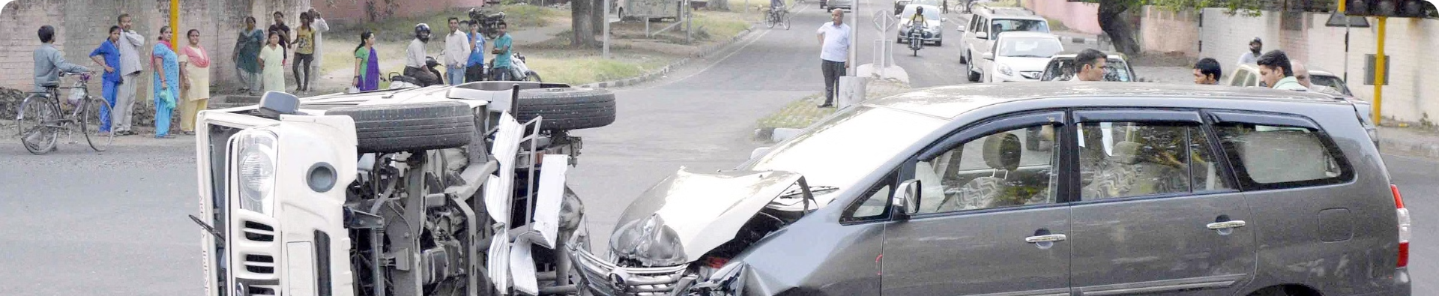
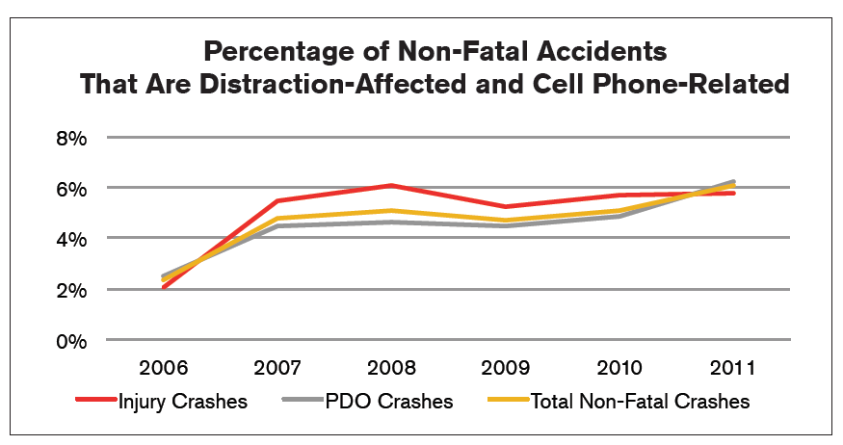
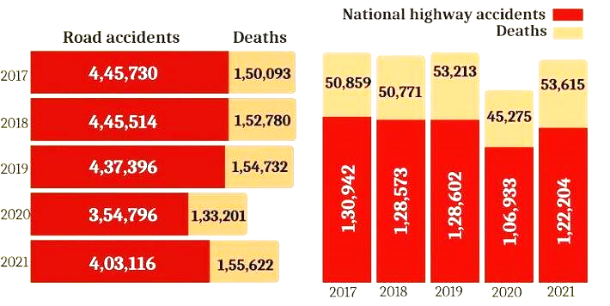
The Magnitude of the Problem:

Slide 3


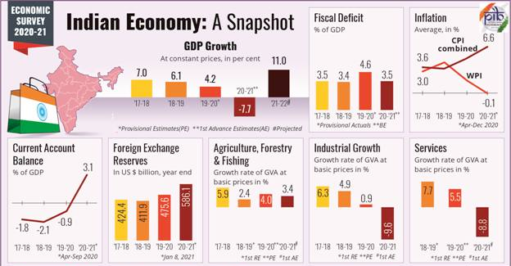
The Human Cost:
1
Tragic Statistics:
More than 16 children die daily in India due to road accidents.
According to 2016, 17 people were killed each hour in India due to road accidents.
There is one death every 4 minutes due to road accidents in India.
2
Economic Impact:
In 2016, the Indian government spent 7.5% of the country's GDP on deaths due to road accidents.
The World Bank estimates that road accidents cost
Rs. 12.5 lakh crores country's GDP in 2016.

Slide 4
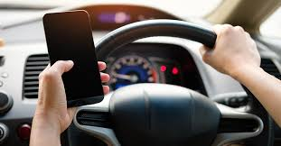


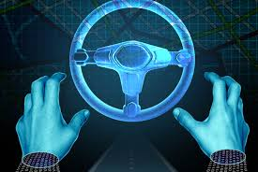
Leading Causes of Accidents: Distracted Drivers:
Driver error is the primary cause of road accidents in India.
This includes factors such as :
- Closing eyes while driving,
- Yawning
- Placing hands away from steering
- Using a Mobile phone while driving
- driving under the influence of alcohol or drugs.
The increasing number of vehicles on the road underscores the urgency to address this issue and implement solutions to prevent accidents.

Slide 5
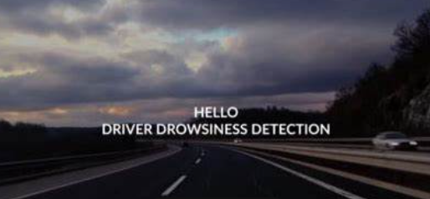
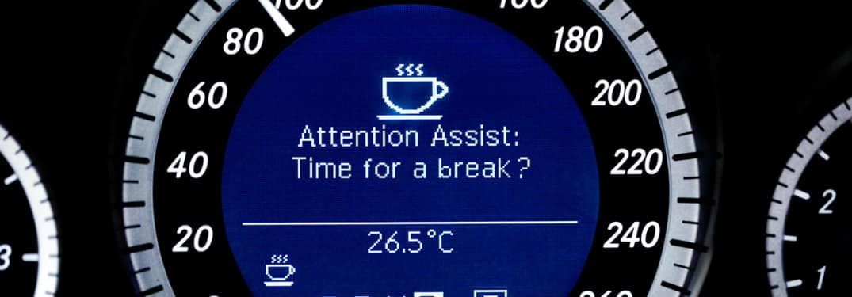
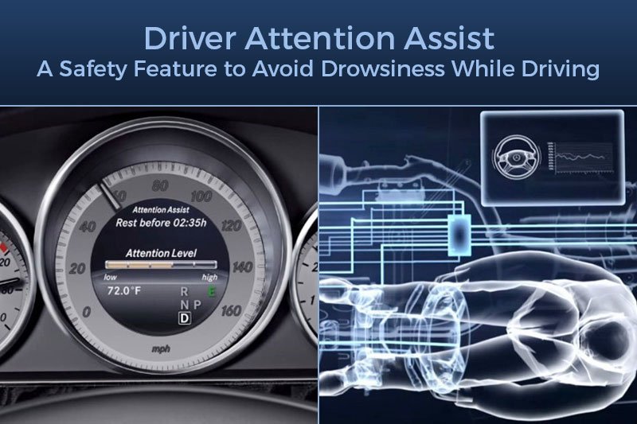
Technology-Based Solutions
Mahindra XUV700
Mercedes-Benz Assisted System
BMW Attention Assisted System
Rumors suggested that Mahindra's XUV700 features a drowsiness detection system that uses a camera to monitor the driver's face for signs of fatigue. The system alerts the driver through vibrating steering wheels or audible notifications.
Mercedes-Benz offers an assisted system that helps prevent accidents by monitoring the driver's behavior and providing alerts.
BMW's Attention Assisted System is another advanced technology designed to detect driver fatigue and alert the driver. Like it is primarily available in high-end vehicles.
However, all these are typically found in luxury cars and are not affordable for the average person.

Slide 6


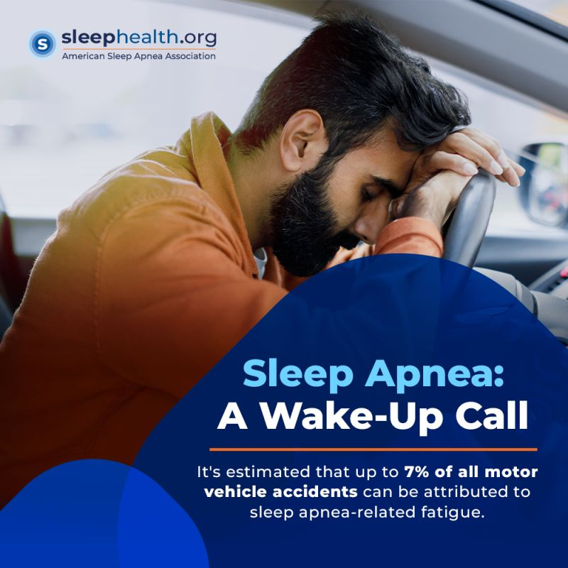
The Impact of Sleep Apnea:
On average, each driver drives for about 11.9 hours in a day terms of average distance covered, a truck driver covers about 417 km daily.
Obstructive Sleep Apnea (OSA) is a serious sleep disorder characterized by recurrent upper airway collapse during sleep this leads to
- breathing interruptions
- derangements in gas exchange
- sympathetic nervous system activation.
Excessive daytime sleepiness (EDS) from OSA increases the risk of motor vehicle accidents.

Slide 7
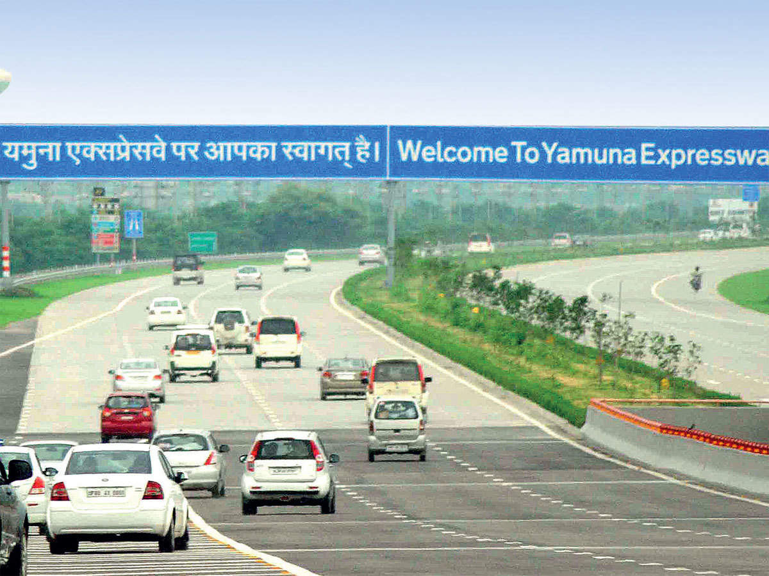
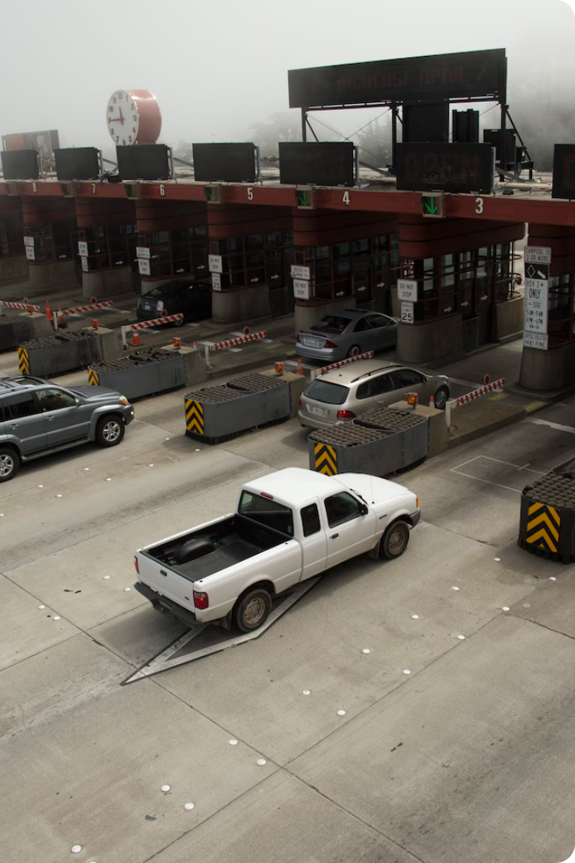
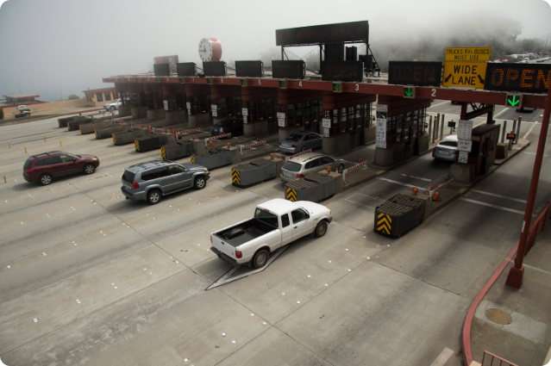
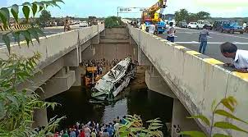
Real-World Data: Yamuna Expressway
1
2012 to 2023
Between 2012 and 2023, there were 1,321 deaths, 11,168 injuries, and 7,625 accidents on the Yamuna Expressway.
2
Drowsy Driving
In 2019 the Union Road Transport and Highways Ministry reported that states 40% of overall vehicle accidents are due to Drowsiness in Drivers

Slide 8

AI-Based Distracted Driving Detection:
1
Facial Expression Analysis
2
Eye Movement Tracking
The system analyzes facial expressions,
including eye blinks,
gaze direction,
mouth movements,
to identify signs of drowsiness, distraction, or inattention.
AI algorithms monitor eye movements, such as prolonged glances away from the road
or slow eye closure,
to detect potential distractions or drowsiness.

Slide 9





The Impact of our Solution
Increased Awareness
Our software will raise awareness among drivers about the dangers of distraction. The real-time feedback provided by the system will help drivers develop safer driving habits and be more mindful of their actions behind the wheel.
Improved Road Safety
By identifying and alerting drivers to distractions, our software can reduce the occurrence of accidents, potentially saving lives and preventing injuries. This can have a significant positive impact on road safety in India.
Reduced Economic Burden
Reducing the number of accidents will significantly reduce the economic burden associated with road accidents, freeing up resources for other essential development initiatives.

Slide 10
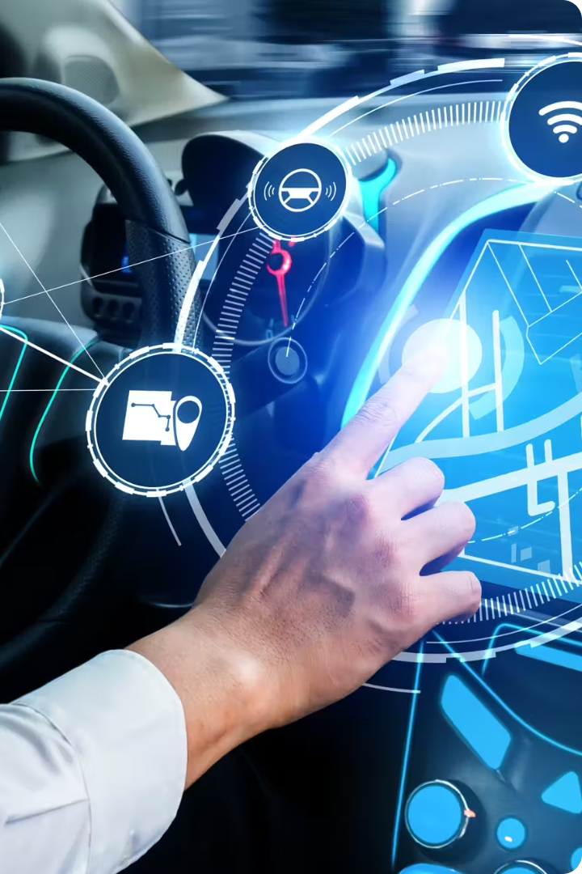
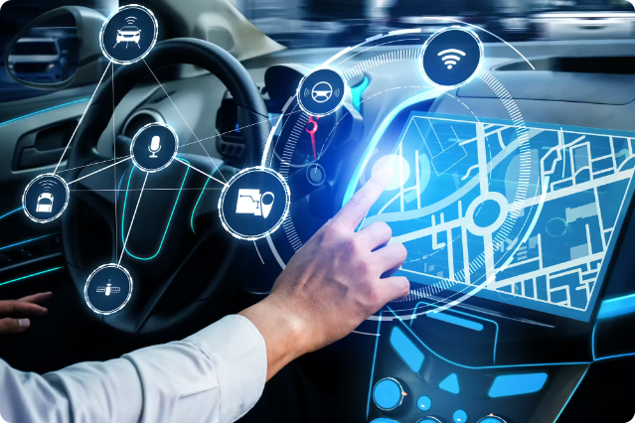
Our Project: Preventing Accidents
Our project aims to mitigate the problem of road accidents by developing a software solution that can accurately identify driver distraction.
This software, when integrated can warn the driver if they become distracted, potentially preventing accidents from happening.

